Slide 1
Children around the world and internet access at home

Slide 2
Introduction
Before COVID-19, one in five children of primary to upper secondary school age was out of school*
It is not only about going to school but also about the quality
children in school are not necessarily learning – 617 million children and youth worldwide, many of whom are in school, cannot read or perform basic mathematics
*UNESCO Institute for Statistics (2018). One in Five Children, Adolesvcents and Youth is Out of School. http://uis.unesco.org/sites/default/files/documents/fs48-one-five-childrenadolescents-youth-out-school-2018-en.pdf

Slide 3
Technology
Digitalization of society: ICT skills and access to technology important
COVID-19 pandemic has caused national school closures in 190 countries (in April 2020) → a huge effect on the global learning crisis → governments/education actors began developing systems to deliver education remotely (radio, television or the internet)
In my analysis I focus on the internet
* UNESCO Institute for Statistics (2017). More Than One-Half of Children and Adolescents Are Not Learning Worldwide. http://uis.unesco.org/sites/default/files/documents/fs46-more-thanhalf-children-not-learning-en-2017.pdf

Slide 4
Dataset
Dataset from databank UNICEF (the world's leading source of data on children used by over 3 million people globally)
Datasource: Household surveys, health surveys
Timeframe: Household survey data as of year 2010 onwards are used to calculate the indicator. For countries with multiple years of data, the most recent dataset is used.
Target: Percentage of children in a school attendance age (about 3-17 years old depending on the country) that have internet connection at home
Internet connection is defined as fixed (no mobile networks)

Slide 5
Regions
Region | # countries | Subregion | # countries
SSA Sub-Saharan Africa | 31 | ESA Eastern and Southern Africa | 13
 |  | WCA West and Central Africa | 18
LAC Latin America and the Caribbean | 20 | LAC Latin America and the Caribbean | 20
ECA Europe and Central Asia | 15 | EECA Eastern Europe and Central Asia | 14
EAP East Asia and the Pacific | 9 | EAP East Asia and the Pacific | 9
SA South Asia | 6 | SA South Asia | 6
MENA Middle East and North Africa | 6 | MENA Middle East and North Africa | 6

Slide 6
Countries
Number of countries worldwide: 195
Number of countries in the dataset: 87 (only 87 countries selected, underlying reason not found)
Some observations:
United States: not included
Australië: not included
Europe: Only United Kingdom
China: included
Russia: included
India: included

Slide 7
Where is my question about?
To understand the factors that influence if children (about 3-17 years old) have an internet connection at home

Slide 8
Variables
Region
Urban/rural
Income group

Slide 9
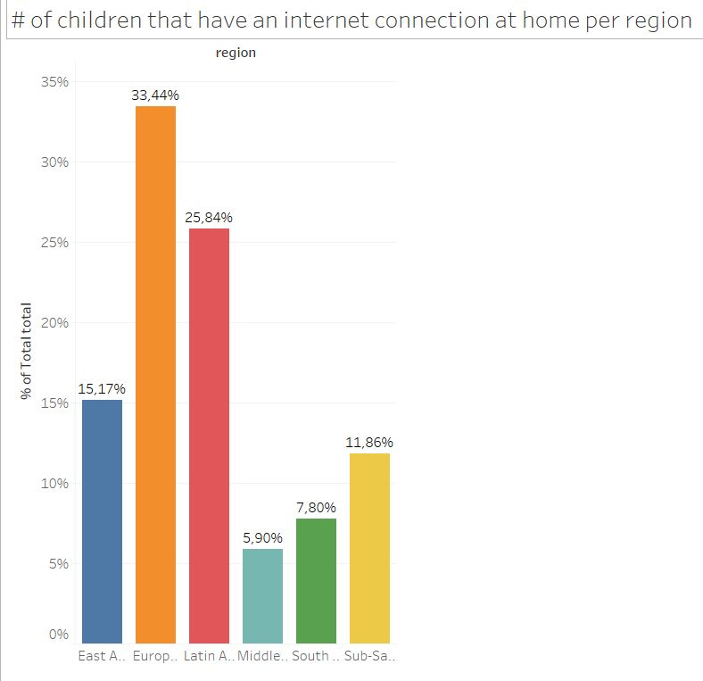
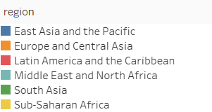
% of children that have an internet connection at home per region

Slide 10
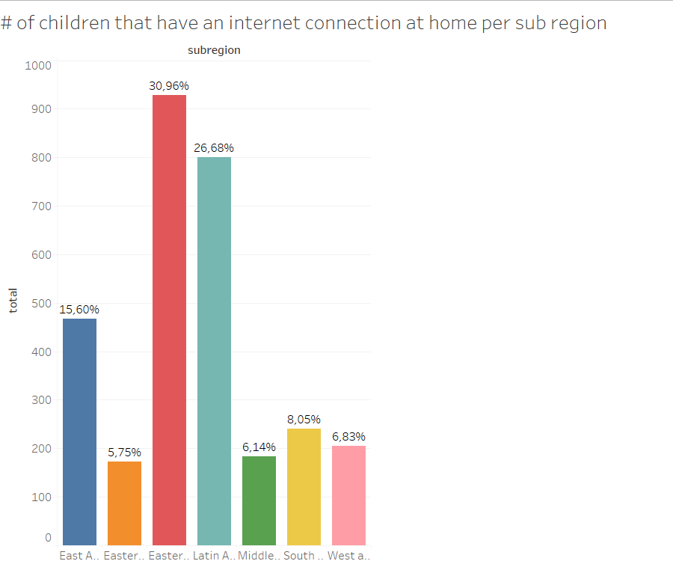
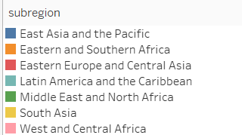
% of children that have an internet connection at home per sub-region

Slide 11
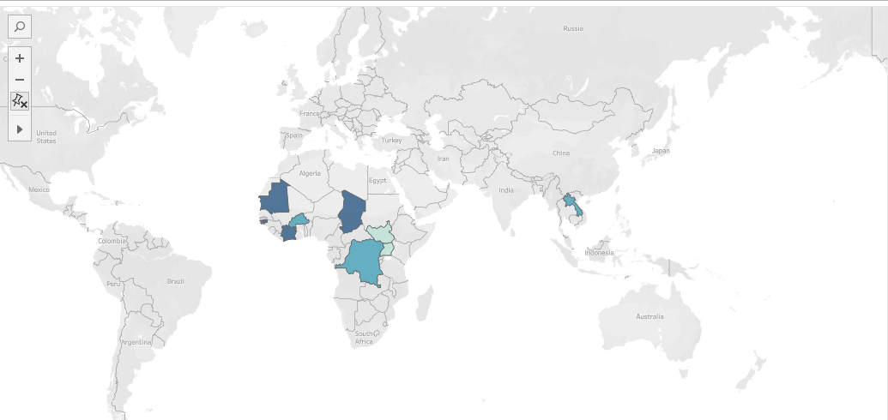
2% or less of the children who have an internet connection at home per country

Slide 12
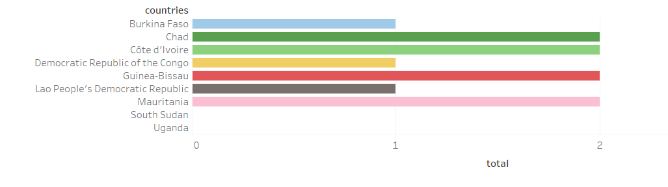
2% or less of the children who have an internet connection at home per country

Slide 13
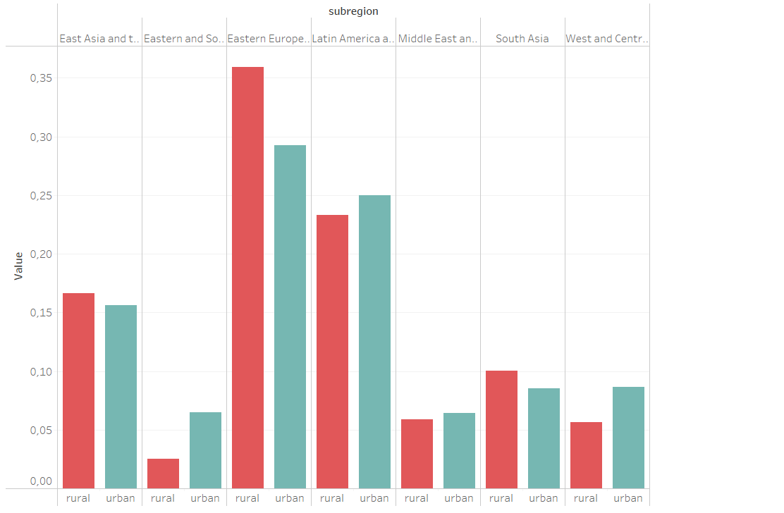

# of children (per region) that have an internet connection at home in urban and rural areas

Slide 14
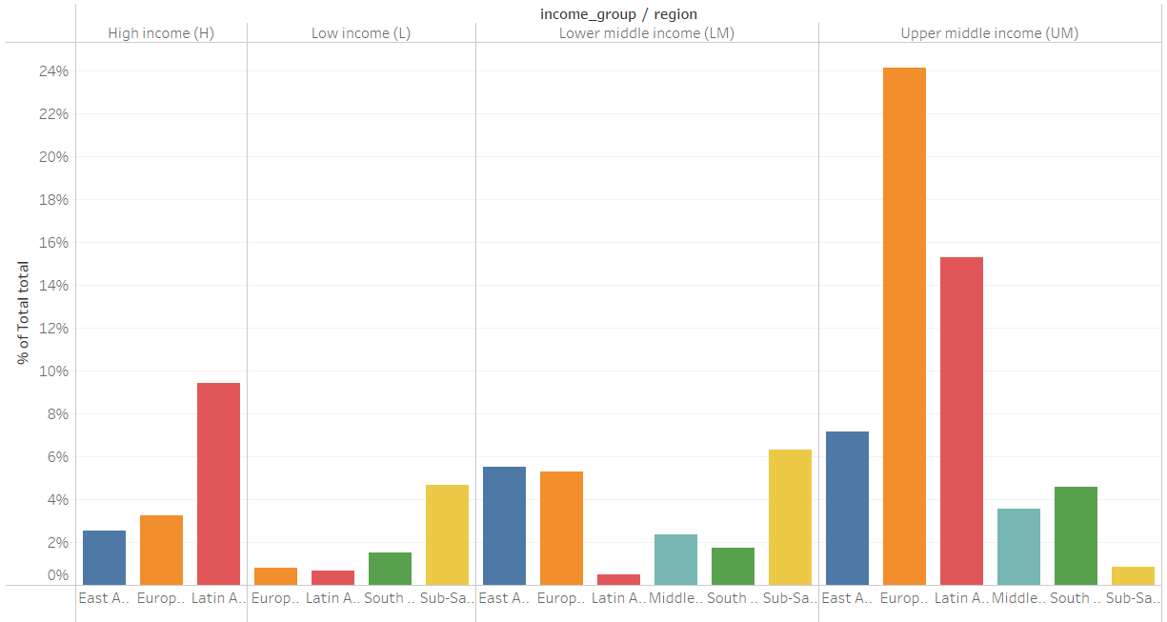
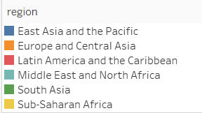
# of children that have an internet connection at home per income group

Slide 15
Conclusions
Major differences within regions
Urban/rural setting less great effect on the number of children with an internet connection at home
9 countries in the dataset where 2% or less of the children have an internet connection at home
Data from more high-income countries to analyze in more detail the differences
Important to look at the countries included and what the (sub) categories entail
An analysis that includes data access internet on mobile phones (huge increase especially in African countries, how does this affect the opportunities for children and their education)?

Slide 16


